Slide 1
What’s New for the Command line and Windows Subsystem for Linux
Dinesh Kumar P
Product Manager, Data sources team, Syncfusion Software
Notes:
Hi, I’m Dinesh Kumar Prabakaran from Syncfusion Software.
I’m a Product Manager in Data sources team.
I’m excited to be here today to talk with you about one of my favorite topics: what’s new for the command line in Windows.
Before that, in a Windows machine I know we can run a Linux OS. In what all ways we can?
Docker
VM
..
Ok. Let it be as it is for now.

Slide 2
What we’ll cover today
The new Windows Terminal
The Windows Subsystem for Linux Today (WSL 1)
The Windows Subsystem for Linux 2 (WSL 2)
Notes:
Lets see what are the three main topics that I cover for the today:
1. The new Windows Terminal
2. Where we are with WSL today
3. And where we are going with WSL in the future.

Slide 3
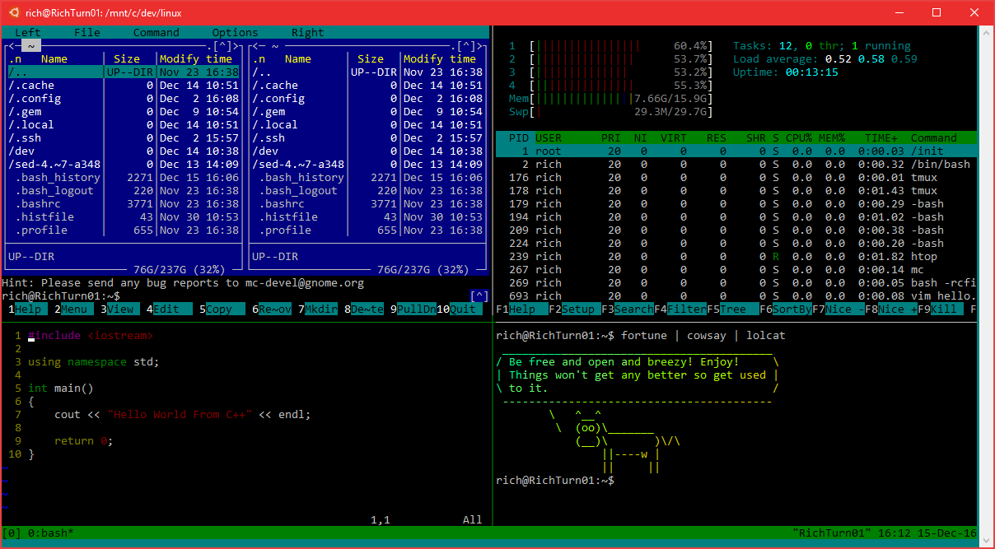
Windows Console
It’s come a looooong way!
Now ~30 years old!
Battle-tested
Fast, small, efficient
We’ve added many features
Transparency, VT, 24-bit color, ConPty
Overhauled innards
Refactored & Modularized
THOUSANDS of LoC replaced with modern C++ & safe, efficient, STL + WIL
Notes:
Click
Console has been around longer than many of the developers ☺
Used by cmd.exe, PowerShell, WSL, etc.
Click
Although the changes aren’t always obvious, we’ve done a lot of work on the console over the years.
For example, supporting 24 bit color, and VT escape sequences, line-selection copy/paste. Of course, we also added transparency as well. (show it)
Click
Internally, we’ve done a lot of refactoring. You can imagine that’s pretty necessary with a 30 year old code-base. We’ve upgraded thousands of lines of code with modern C++, and safe, efficient patterns and libraries.

Slide 4
But …
You all want more
You want tabs, emoji, Unicode / UTF-8, transparency, configurability, themes/styling
SO DO WE!
Console’s primary concern is backward-compatibility
Even small UX changes can “break the world”
Backwards compatible with MS-DOS
At some point, we need to start fresh
That time is now!
Notes:
But …
<click>
we know it was time for some big updates. You all wanted more!
You want tabs, emojis, transparency, better encoding support, configurability, themes/styling and more
<click>
So do we!
<click>
We can’t do that with the existing console app ,though, as even tiny changes can break real-world apps, including entire production lines where automated testing systems are screen-scraping console screens and a small change can bring production to a halt.
<click>
So it’s time to start fresh.

Slide 5

And here it is … Windows Terminal
Notes:
The Windows Terminal

Slide 6
So why should I use Terminal if I am a Linux developer?
If you want to use tools that run on Windows like Adobe Photoshop and need Linux environment for some other development purpose.
If you have some organizational rule-set that you need to use Windows, but just in case you need Linux for a specific project or use case.

Slide 7
And why should I use Terminal if I am a Windows developer?
The world is moving towards Command Line.
Almost all latest software bundles come as cross platform to make it usable in multiple operating systems. Only and quick way of allowing all different OS flavors developers is to make them talk to “Command Line”, instead of building GUI for each OS.
Its from GIT, Big Data tools like Spark / Hadoop, Node JS, Docker, Kubernetes and so on.
Another simple thing is, “If you know to work in command line, then you would be viewed as an Expert. Yes! Its true ☺

Slide 8


WSL 1
♥
Notes:
Before going through about Terminal, lets see the use cases for this new Terminal. One of them was Windows subsystem for Linux.
Who here has used WSL?
(depending on audience, likely to get around ¼ to ½ the room)
I’ve had the opportunity talk with developers who mostly work on other operating systems. In one case, almost no one in the room realized that you could run Linux on Windows! They were thrilled to learn that, not only is it great for web developers, but cross-platform C++ developers can often run their build processes on it as well.
Personally, I use WSL for some tools, but mostly for a replacement for most ssh clients. I run an Ubuntu Minecraft server with my son, and I do all my management of that server and its apps through ssh in WSL.
Note that we’re calling the current version “WSL 1”. We’ll talk about the upcoming “WSL 2” in a few minutes.

Slide 9





WSL 1 Architecture
Linux Distribution
WSL
Windows NT Kernel
Notes:
Here’s a little background on WSL 1
<click>
We have Linux usermode binaries. These are not shipped as part of Windows. You can get them from the store or side-load them.
<click>
The WSL translation layer is a driver that we call lxcore, or Linux core. It implements the Linux kernel ABI and translates Linux syscalls to NT equivalents.
<click>
Then, under that, we have the Windows kernel itself.

Slide 10
WSL 1 Architecture
Linux Distribution
WSL
Windows NT Kernel
Notes:
Linux is rapidly-evolving and adding new features. These need to be reimplemented in our translation layer.
This adds a delay between when the Kernel adds a feature and when it’s available to our users
We want users to have the latest and greatest functionality
Windows is a powerful and flexible platform but there are fundamental differences between Windows kernel and Linux Kernel
Filesystem
Permission model
Memory manager
Device model
These differences can cause performance or compatibility issues.
For example, Implementing filesystem semantics on top of Windows causes slowdown.
This is the primary reason why file IO is slow in WSL1

Slide 11
Demo
A lap around WSL 1
Notes:
In the keynote, you saw remote debugging with VS Code and WSL. That’s one of my favorite web features. Let’s take a step back and look more at what you can do with the WSL, as a web dev, but also as a .NET developer and more.
Let’s take a lap through WSL 1 from the basics to some really interesting tips.

Slide 12
WSL Demo Part 2 : Shell
See recording for timing
Basics (Test this all well in advance in case your PC has permissions issues and you have to use a different folder)
Make an empty folder on your desktop, called “wsltest”
Navigate into the folder with explorer (leave this open for the demo)
Shift and right-click and choose “Open linux shell here”
Or, in that same explorer window, you can type “wsl” in the path nav at the top
This will open WSL (in the old console, but that’s ok here. If you want the new Terminal, you’ll need to run it and then nav to this folder)
Type ls –al or the alias ll to show the contents of the folder
“You can see that my Windows native folder here is available under /mnt/whatever/blah
“All the usual linux commands work”
Type “df” to see disk space and not that it shows all the Windows drives as well
Type “top” to show the processes running in linux. Control-C to exit.
Notepad
In linux, create a new text file of any name like “hello.txt” as long as it ends in “.txt” . Use your favorite editor. I use nano
Make sure to type a few lines of text in the file
Close the editor (nano is control-o to save, control-x to exit) vim is, well, if you’re using vim, you should know how to exit :D
Go back to Windows and double-click the new file
“Windows can access this file because it’s saved in the Windows file system. Hey, check out how Notepad now recognizes that it has Unix line endings, and properly handles that! Cool, right?” <applause, hopefully>
“Launching Windows exes from the Linux shell is a relatively new feature. You can also launch Notepad, or any other exe in the Windows path, directly from WSL.”
In linux, type “notepad.exe <filename>” where filename is the file you created above.

Slide 13
WSL Demo Part 3: Linux file system access
1:45 minutes
As of Windows 10 May 2019 update (19h1 / 1903) Windows can now access the WSL files through built in 9P / Plan 9 file share support.
“With the latest release of Windows, we now have a supported way to access the WSL linux file systems for both WSL 1 and WSL 2. It uses Plan 9 /9P protocol for network access, just like you might between actual physical machines.”
Show how you can access files
Open Windows explorer
Type \\wsl$ in the address box
“You can also type \\wsl$\distroname to go right to the file system for that distro”
Double-click the distro
Click into home/username to look at files
Right-click .bashrc and choose “Open with Code” to show you can open this in VS code in Windows.
“This is a big deal, because access TO the linux file system in the past was cautioned against because you could easily corrupt file properties.”
“In a future build of Windows, you’ll have a nice little Linux icon in the left pane of explorer, so you don’t need to remember the \\wsl$ path.”
Notes:
https://en.wikipedia.org/wiki/9P_(protocol)

Slide 14
WSL Demo Part 4 : .NET Core
See recording for timing
“This linux instance also has .net core 3 installed”
$ cd ~
Type “dotnet” at the wsl command prompt
(if this fails, make sure you’ve put the path and dotnet exports in your .bashrc as indicated in the system requirements/setup at the start of this doc)
“We’re going to use the dotnet console app template to create a Hello World”
$ dotnet new console -o myapp
$ ls -al or ll to show the myapp folder
Edit the program
“You’ve already seen how I can use native Linux editors, as well as invoke the Windows Notepad. I prefer VS code for this type of work”
$ cd myapp
$ code .
Change the “Hello World!” to “Hello <city name> from .net core 3 on WSL!”
Save
Make sure you are still in the ~/myapp folder.
Type $ dotnet run
It will load up .net core runtime and then run the application. You should see console output
“that was super easy. You can do a lot more with this, of course, and it’s an easy way to create linux binaries, test, and more for not just .net, but also python, node, C++, and many other languages, using the convenience of the native toolchains on linux, all without having to spin up a dedicated VM or use a separate linux box.”
“The dotnet.Microsoft.com site has a lot more information about running .net core on Windows, Linux, macOS and more.”

Slide 15
WSL Demo Part 5: X Server
See recording for timing
(This demo tends to really gets people out of their seats. Requires that you have VcxSrv installed and configured on the PC)
“Ok. That was all cool, and helped show the command-line shell capabilities of WSL. But sometimes you want to use a graphical tool on Linux, to test or for other reasons”
“I have running on my PC here, an X-server. I’ve also installed a number of X Windows apps on WSL”
“Now, we don’t officially support running an X-server with WSL, but it does happen to work quite nicely. There are a few different ones out there: x410 in the store, Xming and VcxSrv available online. Of them, devs seem to have more success with VcxSrv. You may get odd errors here and there, but basic applications tend to work.
$ xeyes
“X eyes is fun, but let’s say I want to test behavior with the Linux version of Firefox”
$ firefox
Navigate to InsiderDevTour.com (this won’t work from the command-line, so do it from the app UI)
“Yes, that’s the linux build of Firefox, running in an Xwindow, from WSL, on Windows”
“You can also run full window managers such as xfce or gnome. Again, it’s not officially supported, but there are lots of folks with tutorials online.”
Notes:
If any of this fails
First, make sure you have $ export DISPLAY=:0 either in your .bashrc or typed before you open xeyes
If it still fails, remind folks that it’s not officially supported. ☺
Always reboot after a practice session / before you do this demo live.
In the recording, I also show how I open vcxsrv and run it, and then set the display. Firefox fails because I made the mistake of installing Gnome in this instance and didn’t get to manage all the setup for it.

Slide 16

Top Customer Asks
⏱
File System Performance
Compatibility
Notes:
These were the top two customer requests that we weren’t able to reasonably address in WSL 1.
So…

Slide 17
Introducing: WSL 2
Notes:
We’ve created WSL 2!

Slide 18
What exactly is WSL 2?
Linux Distribution
WSL
Notes:
WSL 2 is a new architecture for WSL, with the primary goals of improving file system performance and compatibility.
We’ve made significant changes to the back end of WSL – the part Linux runs on.
Distro install story doesn’t change. The way you use it doesn’t change. Should be transparent to you.
We call it WSL 2 as we fundamentally changed how WSL interacts with your Linux binaries, and we will be distinguishing between the initial version of WSL, which we will now call WSL 1.
A Linux distro can either be running on top of WSL 1 in the back end or WSL 2, you can switch back and forth. We’re not getting rid of WSL 1, but we think you’ll really like WSL 2.

Slide 19
File System Performance
WSL 2 speed comparison test WSL 1 on a Surface Laptop
git clone
2.5x
faster
npm install
4.7x
faster
cmake
3.1x
faster
Test/Version | WSL 1 | WSL 2 | Linux VM | Mac
Git clone VSCode | 45.86 | 17.63 | 18.368 | 20.51
Npm install | 33.94 | 7.239 | 7.165 | 9.57
Cmake on OpenCV | 123.38 | 39.73 | 21.75 | 44.78
MYSQL Operation | 30.97 | 20.63 | 29.89 | 46.94
Notes:
The first change that you’re going to notice when you start using a distro with WSL 2 in the backend is the file system performance.
<click>
It’s faster. MUCH faster.
In general, you’re going to find that WSL 2 has a noticeable file speed performance increase. Let’s take a look at exactly what that’s like.

Slide 20
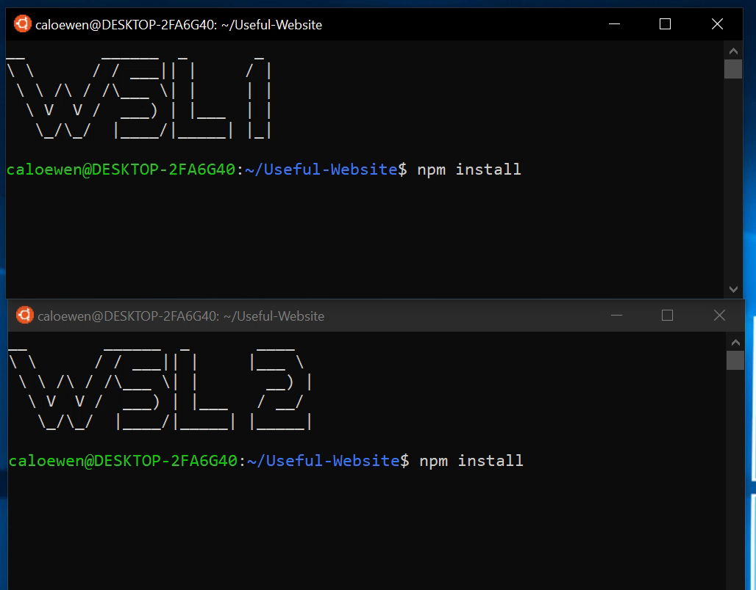
WSL 2 Outperforms WSL 1
Notes:
Check this out. The top is WSL 1, the bottom is WSL 2. Look at how much faster WSL 2 is!

Slide 21
WSL 2 Outperforms WSL 1 - again
Notes:
Let’s look at this one more time, in case you missed it.
I’m going to keep showing this until the whole room applauds!

Slide 22



Differences between Windows and Linux
folder
file.txt
Windows
OpenFile(“C:\\folder\\file.txt”, …);
RemoveDirectory(“C:\\folder”);
ERROR_SHARING_VIOLATION
Linux
open(“/folder/file.txt”, …);
unlink(“/folder”);
SUCCESS
Notes:
So why did we take the new approach?
<click>
In WSL 1, we implemented the Linux syscalls in Windows, and redirected them to the internal NT calls. That resulted in a lot of complexity because the two operating systems have fundamental differences.
<click>
On Windows, you use OpenFile to open a file in a folder
<click>
If you then attempt to remove that folder
<click>
You get a sharing violation.
<click>
On Linux
<click>
You open a file
<click>
If you then unlike (remove)t that folder
<click>
It all works just fine!
One isn’t necessarily better than the other, but different. When we translate the existing calls to NT calls, we have to also translate the behavior. Not only can that affect performance, but there are app compat considerations both for Windows and Linux.

Slide 23


So… How does it work?
Linux Kernel
Virtualization
Notes:
WSL 2 is powered by the latest and greatest virtualization technology, what better way to emulate something than to actually run it!
That’s why we are also using an actual Linux kernel inside of WSL 2. We’re no longer doing the redirection in WSL 2.
So we’re using Virtulization and the Linux kernel, where does this Linux kernel come from? Good question!

Slide 24
Shipping a Linux Kernel with Windows!
Built from Linux 4.19
Latest stable branch
Specially tuned for WSL 2
Fully managed by Microsoft
Built in-house, will be serviced via Windows Update
Open Source! Same source you see at Linux.org
Notes:
We’re starting with the 4.19 kernel. This is the same source you see at Linux.org
We don't just love and use Linux, we’re now shipping Linux!
This kernel is tuned by Microsoft to be optimized for size and performance. We’ve also removed unnecessary device support, and tuned it for WSL 2.
How fast is it? It boots in around a second.
This is fully managed by Microsoft, monitored for security issues, built in-house, and serviced via Windows Update.
By using an actual Linux kernel, we maximize compatibility for the linux applications and services you need.

Slide 25
Light-weight Utility VM
Microsoft’s Virtualization technology has improved since WSL was created.
Light-weight utility VM
Originally developed for Server scenarios
Hyper-V isolated containers
Fast boot time to spin up new containers quickly
High density (low overhead)
Can run lots of containers on a single host machine
Uses real Linux kernel for perfect compatibility and improved performance.
ext4 root filesystem
Notes:
So why did we go back to the idea of virtualization now?
The choices we made for WSL 1 were right for the time. This approach wouldn’t have been possible a few years ago when we first created WSL. One of these improvements is the Light-weight utility VM.
Virtualization stack has LOTS of great new functionality, and the lightweight utility VM, which was originally designed for real-time container spin-up on servers, is perfect for what we’re doing on Windows. It has great isolation, super fast boot time, and very low overhead.

Slide 26
WSL 2 Architecture Overview
Lightweight Linux Utility VM
GNU/Linux Userspace Binaries
Windows Usermode
Linux Usermode
WSL Translation Layer
Windows NT Kernel
Linux Kernel
Hypervisor
Windows NT Kernel
Notes:
So now, rather than Linux Usermode talking to WSL and then to the Kernel, we manage everything in a very standard way, through the hypervisor. The end result is increased performance and compatibility with Linux on Windows
All this leads to better compatibility. That means we can now support things like running Docker containers in WSL.

Slide 27
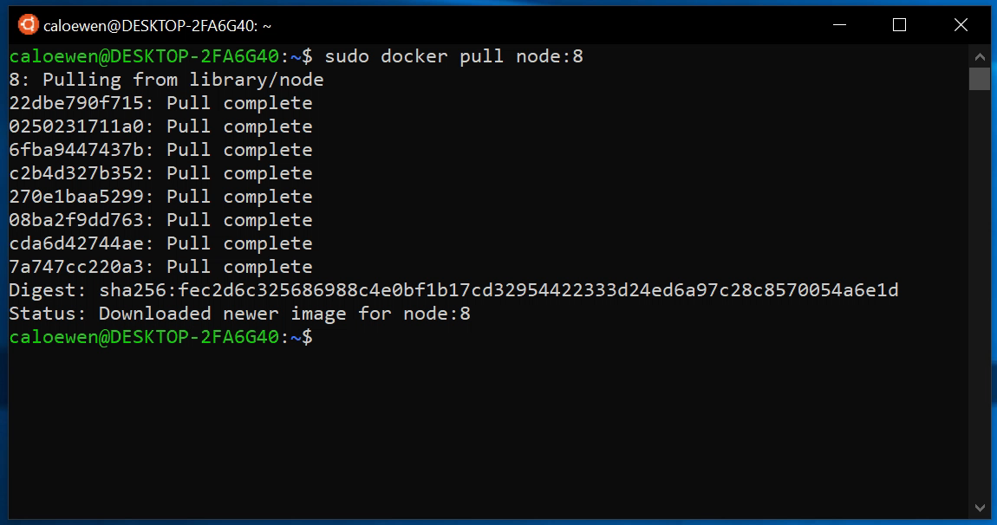
Run Docker in WSL 2!
Notes:
WSL 2 has better sys call compatibility, we can support more applications, like docker!
We've pulled down a node container, and we're just running some simple commands inside of it
This is all being supported by the Linux version of docker, and is running entirely in WSL 2.

Slide 28
WSL 2 Summarized
Greatly improved performance
Better resource usage
Better startup time
Much better native Linux file system performance
Improved compatibility
Full syscall compatibility due to shipped kernel
Did I mention we’re shipping a Linux kernel with Windows?
Standard way to access Linux files
Plan 9 / 9P – Also in WSL 1 as of Windows May 2019 update
Coming to Windows 10 Insider Builds this summer!
Notes:
WSL 1 is awesome and available today
WSL 2 has greatly improved performance.
It has improved compatibility so your Linux applications will just work.
Look for it in the Windows 10 Insider builds this summer

Slide 29
WSL Roadmap
=
🙋‍♀️
🙏
Continue to make WSL 2 feel the same as WSL 1
Improving Integration
Top Customer Asks
Notes:
Right now, we’re focused on making WSL 2 as feature rich and capable as WSL 1, while continuing to ensure performance is better, and we have everything developers on Windows need.
When you get the Insider Build (you’re all Windows Insiders, right?!) We’d love for you to try it out and send us your feedback.

Slide 30
The Command line on Windows
For Developers and IT Pros, Windows now has the best command-line experience ever!
PowerShell
cmd.exe
Windows Subsystem for Linux 1
Windows Subsystem for Linux 2
Windows Terminal
Notes:
Between WSL and the new Windows Terminal, we want to help developers and IT pros be as productive as possible, and enjoy what they do.
We hope you try out Terminal and WSL today!

Slide 31
aka.ms/insiderdevtour-labs
Notes:
“This session doesn’t have a specific lab, but we have lots of other labs that you should check out on Dev Collective, many of which include command-line and WSL components.”
Thanks!

Slide 32
Notes:
And I am open to have “Questions”

